Slide 1
K-Means Clustering and Gaussian Mixture Model
Il-Chul Moon
Dept. of Industrial and Systems Engineering
KAIST
icmoon@kaist.ac.kr

Slide 2
Weekly Objectives
Understand the clustering task and the K-means algorithm
  Know what the unsupervised learning is
  Understand the K-means iterative process
  Know the limitation of the K-means algorithm
Understand the Gaussian mixture model
  Know the multinomial distribution and the multivariate Gaussian distribution
  Know why mixture models are useful
  Understand how the parameter updates are derived from the Gaussian mixture model
Understand the EM algorithm
  Know the fundamentals of the EM algorithm
  Know how to derive the EM updates of a model

Slide 3
Gaussian mixture model

Slide 4
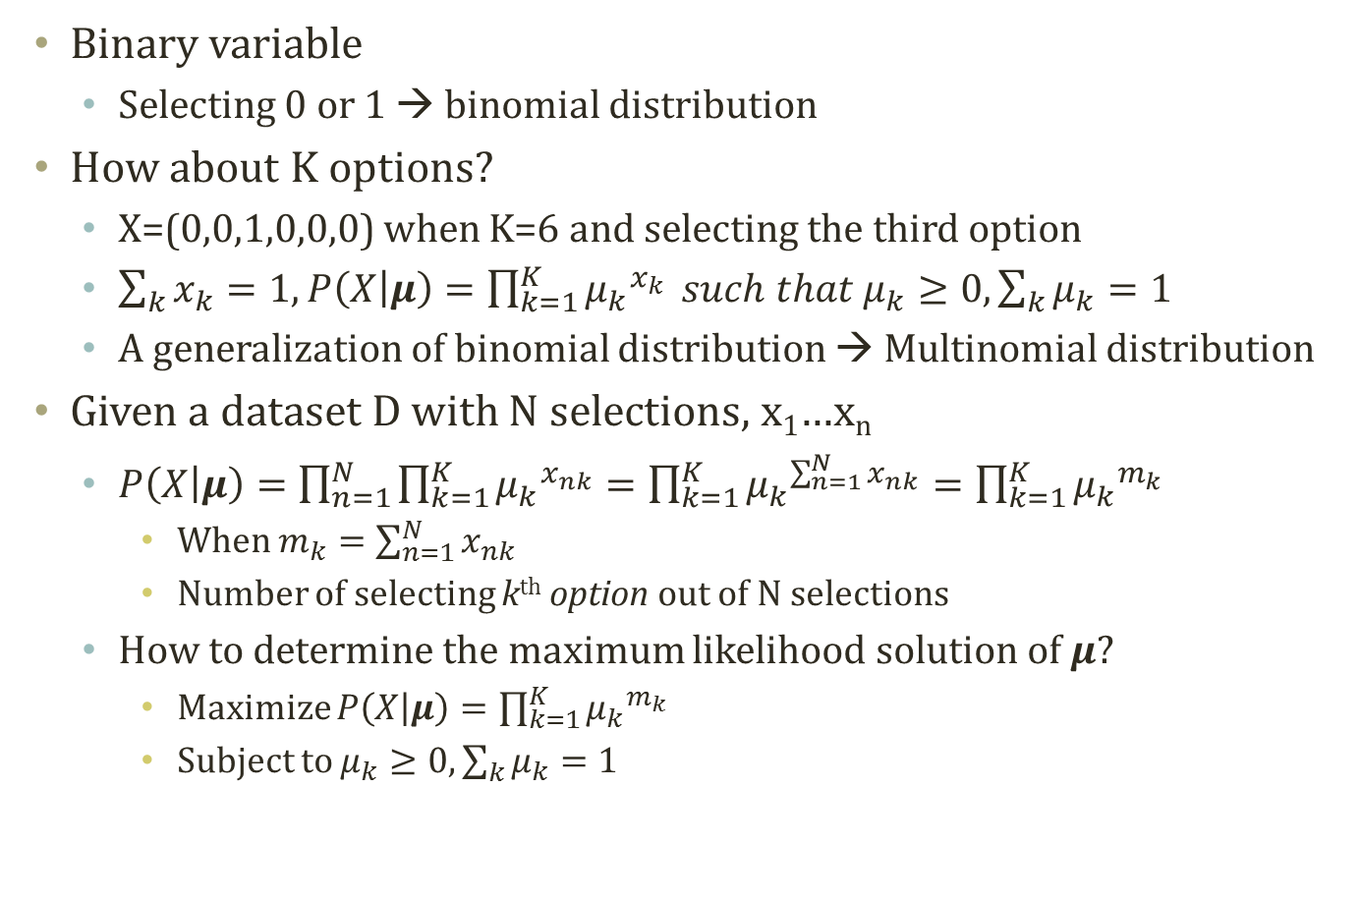
Multinomial Distribution
Binary variable
  Selecting 0 or 1 → binomial distribution
How about K options?
  X=(0,0,1,0,0,0) when K=6 and selecting the third option
  $\sum_{k}{x_{k}}=1, P\left(X | μ\right)=\prod_{k=1}^{K}{{μ_{k}}^{x_{k}}} such that μ_{k}≥0,\sum_{k}{μ_{k}}=1$
  A generalization of binomial distribution → Multinomial distribution
Given a dataset D with N selections, x₁…x_{n}
  $P\left(X | μ\right)=\prod_{n=1}^{N}{\prod_{k=1}^{K}{{μ_{k}}^{x_{nk}}}}=\prod_{k=1}^{K}{{μ_{k}}^{\sum_{n=1}^{N}{x_{nk}}}}=\prod_{k=1}^{K}{{μ_{k}}^{m_{k}}}$
    When $m_{k}=\sum_{n=1}^{N}{x_{nk}}$
    Number of selecting k^{th} option out of N selections
  How to determine the maximum likelihood solution of $μ$?
    Maximize $P\left(X | μ\right)=\prod_{k=1}^{K}{{μ_{k}}^{m_{k}}}$
    Subject to $μ_{k}≥0,\sum_{k}{μ_{k}}=1$

Slide 5
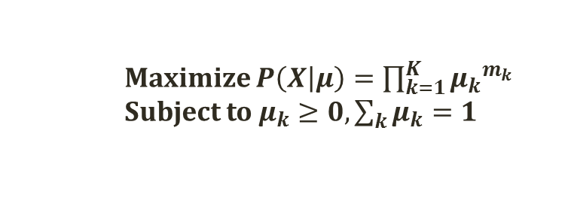
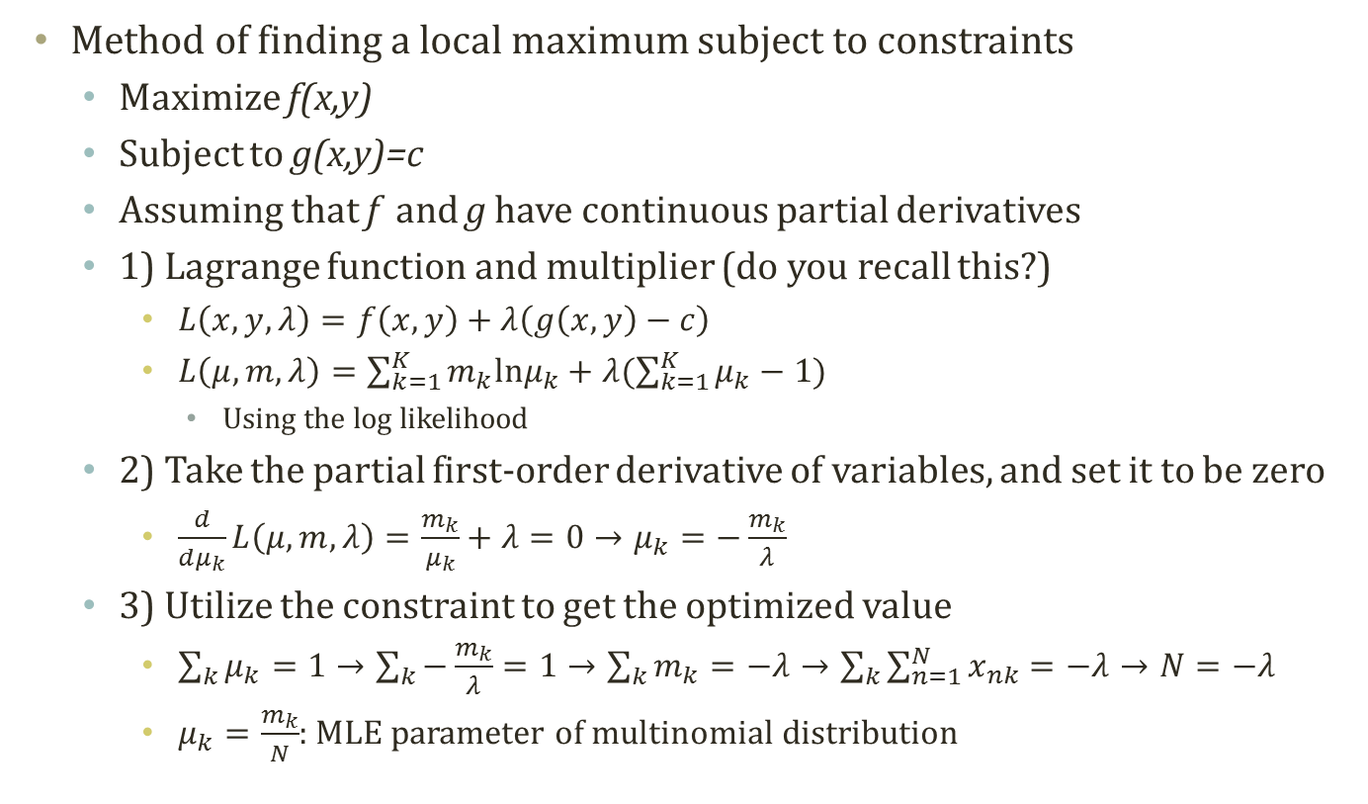
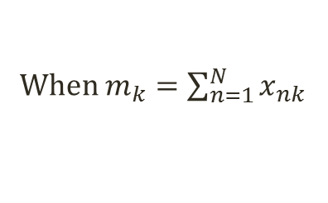
Lagrange Method
    Maximize $P\left(X | μ\right)=\prod_{k=1}^{K}{{μ_{k}}^{m_{k}}}$
    Subject to $μ_{k}≥0,\sum_{k}{μ_{k}}=1$
When $m_{k}=\sum_{n=1}^{N}{x_{nk}}$
Method of finding a local maximum subject to constraints
  Maximize f(x,y)
  Subject to g(x,y)=c
  Assuming that f and g have continuous partial derivatives
  1) Lagrange function and multiplier (do you recall this?)
    $L\left(x,y,λ\right)=f\left(x,y\right)+λ\left(g\left(x,y\right)−c\right)$
    $L\left(μ,m,λ\right)=\sum_{k=1}^{K}{m_{k}lnμ_{k}}+λ(\sum_{k=1}^{K}{μ_{k}}−1)$
      Using the log likelihood
  2) Take the partial first-order derivative of variables, and set it to be zero
    $\frac{d}{dμ_{k}}L\left(μ,m,λ\right)=\frac{m_{k}}{μ_{k}}+λ=0→μ_{k}=−\frac{m_{k}}{λ}$
  3) Utilize the constraint to get the optimized value
    $\sum_{k}{μ_{k}}=1→\sum_{k}{−\frac{m_{k}}{λ}}=1→\sum_{k}{m_{k}}=−λ→\sum_{k}{\sum_{n=1}^{N}{x_{nk}}}=−λ→N=−λ$
    $μ_{k}=\frac{m_{k}}{N}$: MLE parameter of multinomial distribution

Slide 6
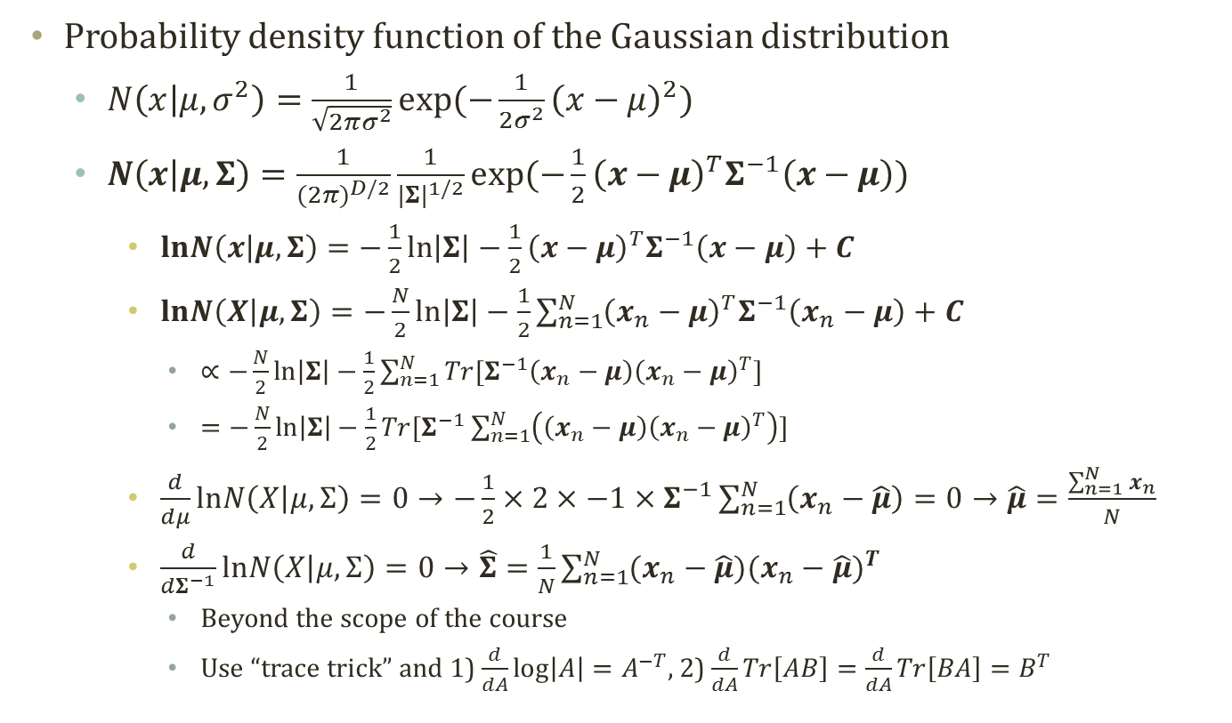
Multivariate Gaussian Distribution
Probability density function of the Gaussian distribution
  $N\left(x | μ,σ^{2}\right)=\frac{1}{\sqrt{2πσ^{2}}}\exp{(−\frac{1}{2σ^{2}}{\left(x−μ\right)}^{2})}$
  $N\left(x | μ,Σ\right)=\frac{1}{{(2π)}^{D/2}}\frac{1}{{|Σ|}^{1/2}}exp⁡(−\frac{1}{2}{\left(x−μ\right)}^{T}Σ^{−1}\left(x−μ\right))$
    $lnN\left(x | μ,Σ\right)=−\frac{1}{2}\ln\left|Σ\right|−\frac{1}{2}{\left(x−μ\right)}^{T}Σ^{−1}\left(x−μ\right)+C$
    $lnN\left(X | μ,Σ\right)=−\frac{N}{2}\ln\left|Σ\right|−\frac{1}{2}\sum_{n=1}^{N}{{\left(x_{n}−μ\right)}^{T}Σ^{−1}\left(x_{n}−μ\right)}+C$
      $∝−\frac{N}{2}\ln\left|Σ\right|−\frac{1}{2}\sum_{n=1}^{N}{Tr[Σ^{−1}\left(x_{n}−μ\right){\left(x_{n}−μ\right)}^{T}]}$
      $=−\frac{N}{2}\ln\left|Σ\right|−\frac{1}{2}Tr[Σ^{−1}\sum_{n=1}^{N}{\left(\left(x_{n}−μ\right){\left(x_{n}−μ\right)}^{T}\right)}]$
    $\frac{d}{dμ}lnN\left(X | μ,Σ\right)=0→−\frac{1}{2}×2×−1×Σ^{−1}\sum_{n=1}^{N}{\left(x_{n}−\hat{μ}\right)}=0→\hat{μ}=\frac{\sum_{n=1}^{N}{x_{n}}}{N}$
    $\frac{d}{dΣ^{−1}}lnN\left(X | μ,Σ\right)=0→\hat{Σ}=\frac{1}{N}\sum_{n=1}^{N}{(x_{n}−\hat{μ}){(x_{n}−\hat{μ})}^{T}}$
      Beyond the scope of the course
      Use “trace trick” and 1) $\frac{d}{dA}\log\left|A\right|=A^{−T}$, 2) $\frac{d}{dA}Tr\left[AB\right]=\frac{d}{dA}Tr\left[BA\right]=B^{T}$

Slide 7



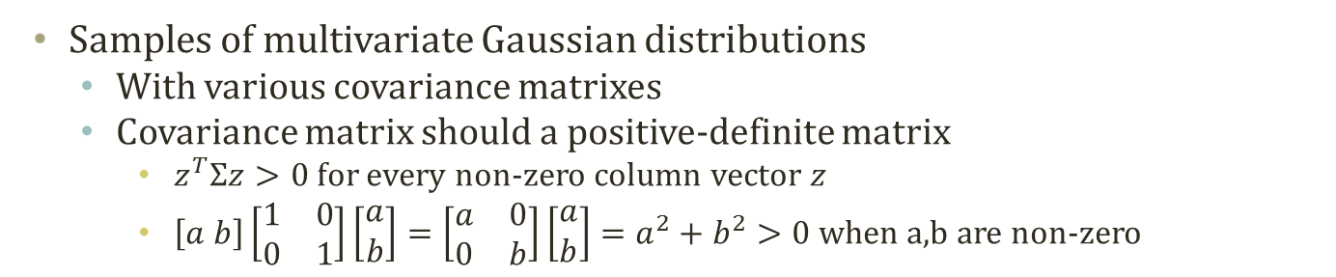





Samples of Multivariate Gaussian Distribution
Samples of multivariate Gaussian distributions
  With various covariance matrixes
  Covariance matrix should a positive-definite matrix
    $z^{T}Σz>0$for every non-zero column vector $z$
    $\left[a b\right]\left[\begin{matrix}1 & 0 \\ 0 & 1\end{matrix}\right]\left[\begin{matrix}a \\ b\end{matrix}\right]=\left[\begin{matrix}a & 0 \\ 0 & b\end{matrix}\right]\left[\begin{matrix}a \\ b\end{matrix}\right]=a^{2}+b^{2}>0$ when a,b are non-zero
$$\left[\begin{matrix}1 & 1 \\ 1 & 1\end{matrix}\right]$$
$$\left[\begin{matrix}0 & 0 \\ 0 & 0\end{matrix}\right]$$
$$\left[\begin{matrix}1 & 0 \\ 0 & 0\end{matrix}\right]$$
$$\left[\begin{matrix}1 & 0 \\ 0 & 1\end{matrix}\right]$$
$$\left[\begin{matrix}5 & 0 \\ 0 & 1\end{matrix}\right]$$
$$\left[\begin{matrix}1 & 0 \\ 0 & 5\end{matrix}\right]$$
$$\left[\begin{matrix}2 & 1 \\ 1 & 2\end{matrix}\right]$$
$$\left[\begin{matrix}2 & −1 \\ −1 & 2\end{matrix}\right]$$

Slide 8
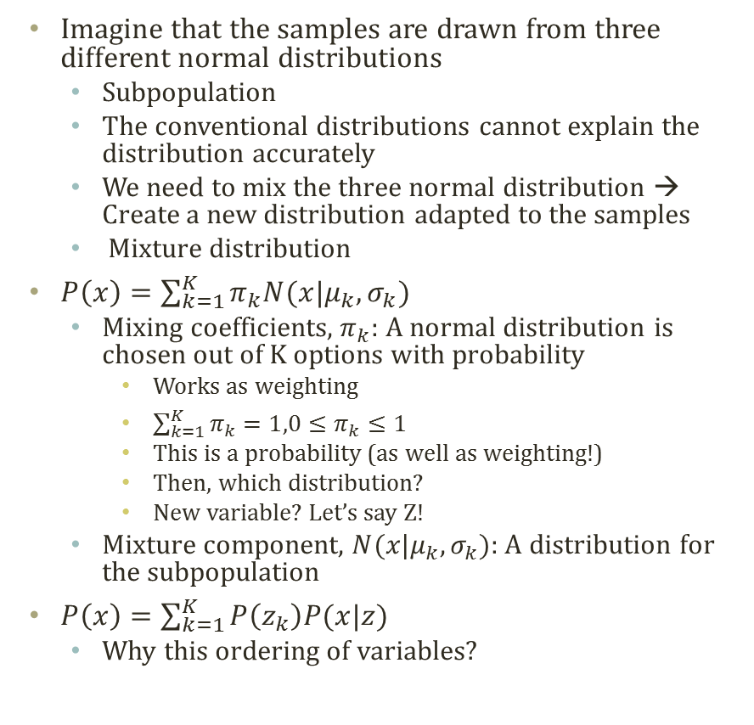
Mixture Model
Imagine that the samples are drawn from three different normal distributions
  Subpopulation
  The conventional distributions cannot explain the distribution accurately
  We need to mix the three normal distribution → Create a new distribution adapted to the samples
  Mixture distribution
$P\left(x\right)=\sum_{k=1}^{K}{π_{k}N(x|μ_{k},σ_{k})}$
  Mixing coefficients, $π_{k}$: A normal distribution is chosen out of K options with probability
    Works as weighting
    $\sum_{k=1}^{K}{π_{k}}=1,0≤π_{k}≤1$
    This is a probability (as well as weighting!)
    Then, which distribution?
    New variable? Let’s say Z!
  Mixture component, $N(x|μ_{k},σ_{k})$: A distribution for the subpopulation
$P\left(x\right)=\sum_{k=1}^{K}{P\left(z_{k}\right)P(x|z) }$
  Why this ordering of variables?

Slide 9

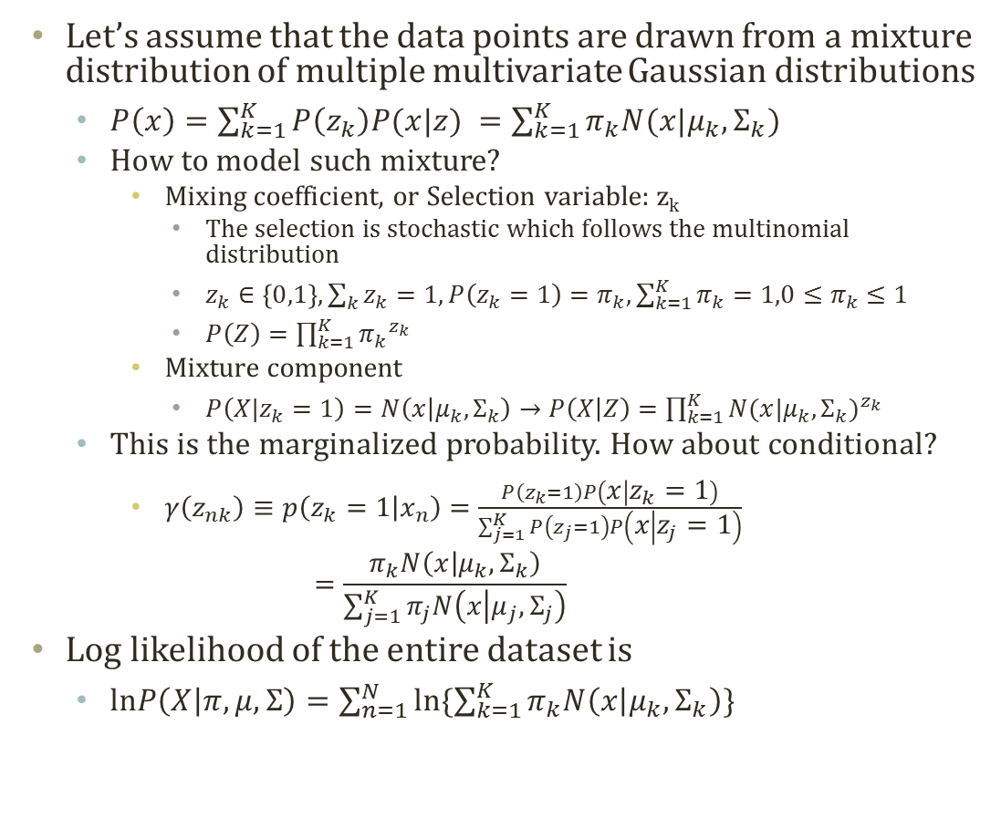


Gaussian Mixture Model
Let’s assume that the data points are drawn from a mixture distribution of multiple multivariate Gaussian distributions
  $P\left(x\right)=\sum_{k=1}^{K}{P\left(z_{k}\right)P(x|z) }=\sum_{k=1}^{K}{π_{k}N(x|μ_{k},Σ_{k})}$
  How to model such mixture?
    Mixing coefficient, or Selection variable: z_{k}
      The selection is stochastic which follows the multinomial distribution
      $z_{k}∈\left\{0,1\right\}, \sum_{k}{z_{k}}=1, P\left(z_{k}=1\right)=π_{k},\sum_{k=1}^{K}{π_{k}}=1,0≤π_{k}≤1$
      $P\left(Z\right)=\prod_{k=1}^{K}{{π_{k}}^{z_{k}}}$
    Mixture component
      $P\left(X|z_{k}=1\right)=N\left(x | μ_{k},Σ_{k}\right)→P\left(X | Z\right)=\prod_{k=1}^{K}{{N(x|μ_{k},Σ_{k})}^{z_{k}}}$
  This is the marginalized probability. How about conditional?
    $γ\left(z_{nk}\right)≡p\left(z_{k}=1 | x_{n}\right)=\frac{P\left(z_{k}=1\right)P\left(x | z_{k}=1\right)}{\sum_{j=1}^{K}{P\left(z_{j}=1\right)P\left(x | z_{j}=1\right)}}$
    $=\frac{π_{k}N\left(x | μ_{k},Σ_{k}\right)}{\sum_{j=1}^{K}{π_{j}N\left(x | μ_{j},Σ_{j}\right)}}$
Log likelihood of the entire dataset is
  $lnP\left(X | π,μ,Σ\right)=\sum_{n=1}^{N}{ln\{\sum_{k=1}^{K}{π_{k}N\left(x | μ_{k},Σ_{k}\right)}\}}$
$$π$$
z
$$μ$$
$$Σ$$
x
N

Slide 10
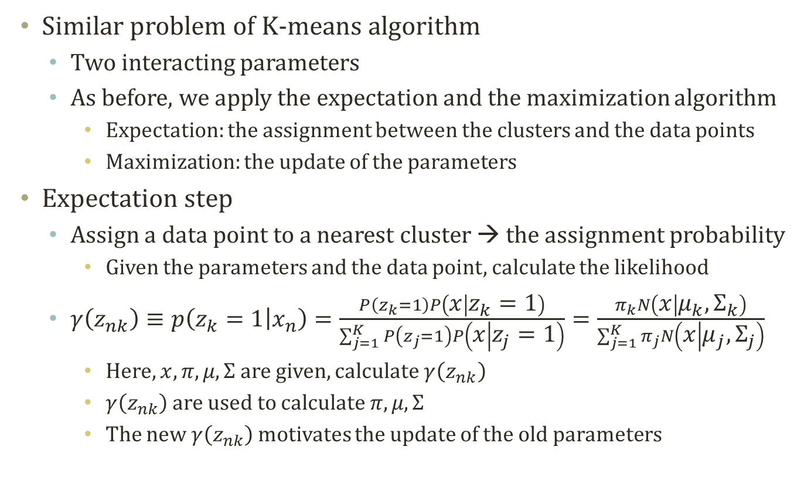
Expectation of GMM
Similar problem of K-means algorithm
  Two interacting parameters
  As before, we apply the expectation and the maximization algorithm
    Expectation: the assignment between the clusters and the data points
    Maximization: the update of the parameters
Expectation step
  Assign a data point to a nearest cluster → the assignment probability
    Given the parameters and the data point, calculate the likelihood
  $γ\left(z_{nk}\right)≡p\left(z_{k}=1 | x_{n}\right)=\frac{P\left(z_{k}=1\right)P\left(x | z_{k}=1\right)}{\sum_{j=1}^{K}{P\left(z_{j}=1\right)P\left(x | z_{j}=1\right)}}=\frac{π_{k}N\left(x | μ_{k},Σ_{k}\right)}{\sum_{j=1}^{K}{π_{j}N\left(x | μ_{j},Σ_{j}\right)}}$
    Here, $x,π,μ, Σ$ are given, calculate $γ\left(z_{nk}\right)$
    $γ\left(z_{nk}\right)$ are used to calculate $π,μ, Σ$
    The new $γ\left(z_{nk}\right)$ motivates the update of the old parameters

Slide 11
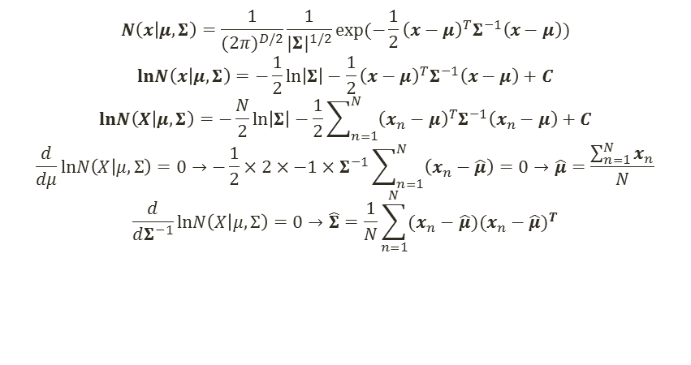
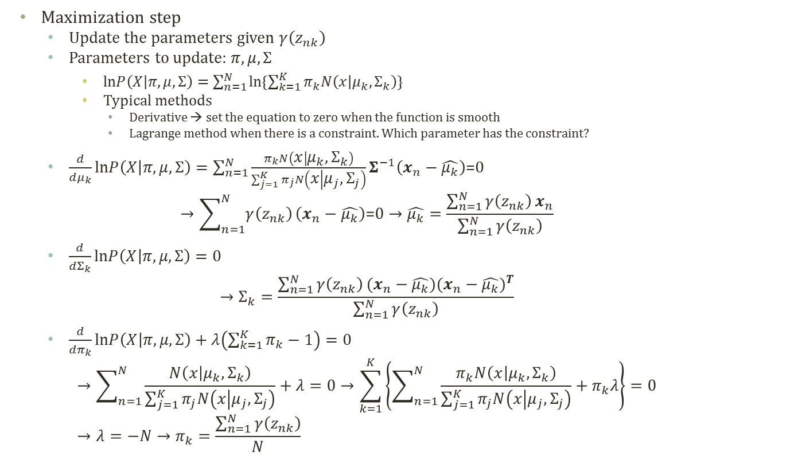

Maximization of GMM
  $$N\left(x | μ,Σ\right)=\frac{1}{{(2π)}^{D/2}}\frac{1}{{|Σ|}^{1/2}}exp⁡(−\frac{1}{2}{\left(x−μ\right)}^{T}Σ^{−1}\left(x−μ\right))$$
    $$lnN\left(x | μ,Σ\right)=−\frac{1}{2}\ln\left|Σ\right|−\frac{1}{2}{\left(x−μ\right)}^{T}Σ^{−1}\left(x−μ\right)+C$$
    $$lnN\left(X | μ,Σ\right)=−\frac{N}{2}\ln\left|Σ\right|−\frac{1}{2}\sum_{n=1}^{N}{{\left(x_{n}−μ\right)}^{T}Σ^{−1}\left(x_{n}−μ\right)}+C$$
    $$\frac{d}{dμ}lnN\left(X | μ,Σ\right)=0→−\frac{1}{2}×2×−1×Σ^{−1}\sum_{n=1}^{N}{\left(x_{n}−\hat{μ}\right)}=0→\hat{μ}=\frac{\sum_{n=1}^{N}{x_{n}}}{N}$$
    $$\frac{d}{dΣ^{−1}}lnN\left(X | μ,Σ\right)=0→\hat{Σ}=\frac{1}{N}\sum_{n=1}^{N}{(x_{n}−\hat{μ}){(x_{n}−\hat{μ})}^{T}}$$
Maximization step
  Update the parameters given $γ\left(z_{nk}\right)$
  Parameters to update: $π,μ, Σ$
    $lnP\left(X | π,μ,Σ\right)=\sum_{n=1}^{N}{ln\{\sum_{k=1}^{K}{π_{k}N\left(x | μ_{k},Σ_{k}\right)}\}}$
    Typical methods
      Derivative → set the equation to zero when the function is smooth
      Lagrange method when there is a constraint. Which parameter has the constraint?
  $\frac{d}{dμ_{k}}lnP\left(X | π,μ,Σ\right)=\sum_{n=1}^{N}{\frac{π_{k}N\left(x | μ_{k},Σ_{k}\right)}{\sum_{j=1}^{K}{π_{j}N\left(x | μ_{j},Σ_{j}\right)}}}Σ^{−1}\left(x_{n}−\hat{μ_{k}}\right)\text{=0}$
  $→\sum_{n=1}^{N}{γ\left(z_{nk}\right)}\left(x_{n}−\hat{μ_{k}}\right)\text{=0}→\hat{μ_{k}}=\frac{\sum_{n=1}^{N}{γ\left(z_{nk}\right)}x_{n}}{\sum_{n=1}^{N}{γ\left(z_{nk}\right)}}$
  $\frac{d}{dΣ_{k}}lnP\left(X | π,μ,Σ\right)=0$
  $→Σ_{k}=\frac{\sum_{n=1}^{N}{γ\left(z_{nk}\right)}(x_{n}−\hat{μ_{k}}){(x_{n}−\hat{μ_{k}})}^{T}}{\sum_{n=1}^{N}{γ\left(z_{nk}\right)}}$
  $\frac{d}{dπ_{k}}lnP\left(X | π,μ,Σ\right)+λ\left(\sum_{k=1}^{K}{π_{k}}−1\right)=0$
  $→\sum_{n=1}^{N}{\frac{N\left(x | μ_{k},Σ_{k}\right)}{\sum_{j=1}^{K}{π_{j}N\left(x | μ_{j},Σ_{j}\right)}}}+λ=0→\sum_{k=1}^{K}{\left\{\sum_{n=1}^{N}{\frac{π_{k}N\left(x | μ_{k},Σ_{k}\right)}{\sum_{j=1}^{K}{π_{j}N\left(x | μ_{j},Σ_{j}\right)}}}+π_{k}λ\right\}}=0$
  $→λ=−N→π_{k}=\frac{\sum_{n=1}^{N}{γ\left(z_{nk}\right)}}{N}$
$$γ\left(z_{nk}\right)=\frac{π_{k}N\left(x | μ_{k},Σ_{k}\right)}{\sum_{j=1}^{K}{π_{j}N\left(x | μ_{j},Σ_{j}\right)}}$$

Slide 12
Progress of
GMM
Soft clustering
  Estimated parameters
  Soft assignment of data points to clusters

Slide 13
Properties of GMM
K-Means Algorithm
Pros and cons of Gaussian mixture model
  Pros
    More information
      Soft clustering
      Not a simple and discrete assignment
        Information loss
    More and more information
      Learn the latent distribution
      Distance is not always the answer of the distribution
  Cons
    Long computation time
      Why?
    Falling into local maximum
    Deciding K
Anyways to mitigate the disadvantage?
  Fast K-means and slow GMM
Gaussian Mixture Model

Slide 14
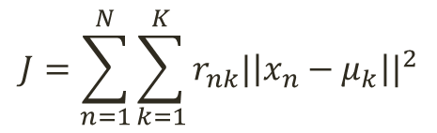
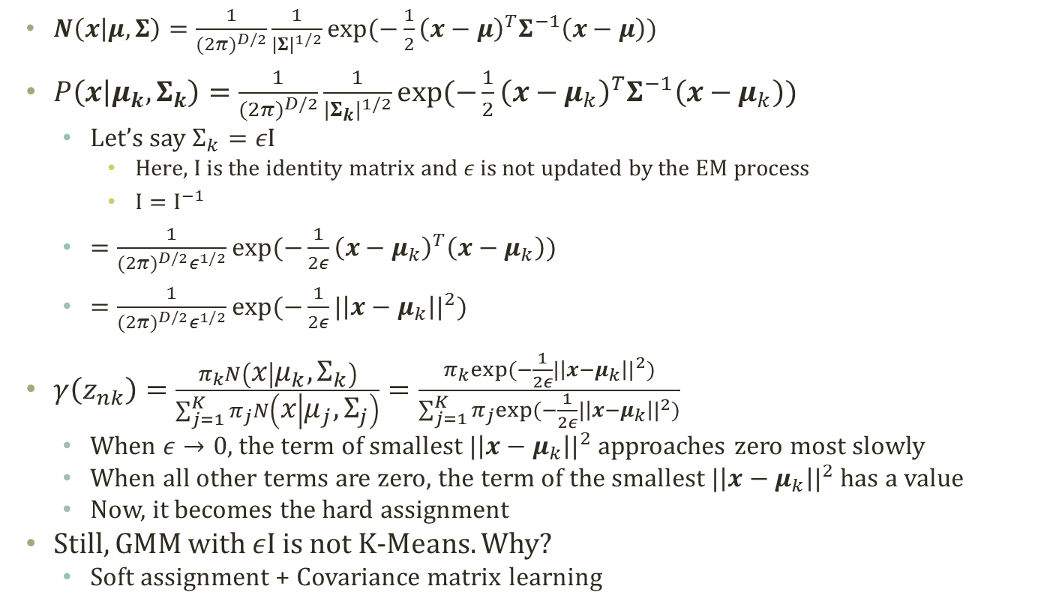
Relation between K-Means and GMM
  $N\left(x | μ,Σ\right)=\frac{1}{{(2π)}^{D/2}}\frac{1}{{|Σ|}^{1/2}}exp⁡(−\frac{1}{2}{\left(x−μ\right)}^{T}Σ^{−1}\left(x−μ\right))$
$P\left(x | μ_{k}, Σ_{k}\right)=\frac{1}{{(2π)}^{D/2}}\frac{1}{{|Σ_{k}|}^{1/2}}exp⁡(−\frac{1}{2}{\left(x−μ_{k}\right)}^{T}Σ^{−1}\left(x−μ_{k}\right))$
  Let’s say $Σ_{k}=εΙ$
    Here, I is the identity matrix and $ε$ is not updated by the EM process
    $Ι=Ι^{−1}$
  $=\frac{1}{{(2π)}^{D/2}ε^{1/2}}exp⁡(−\frac{1}{2ε}{\left(x−μ_{k}\right)}^{T}\left(x−μ_{k}\right))$
  $=\frac{1}{{(2π)}^{D/2}ε^{1/2}}exp⁡(−\frac{1}{2ε}{|\left|x−μ_{k}\right||}^{2})$
$γ\left(z_{nk}\right)=\frac{π_{k}N\left(x | μ_{k},Σ_{k}\right)}{\sum_{j=1}^{K}{π_{j}N\left(x | μ_{j},Σ_{j}\right)}}=\frac{π_{k}exp⁡(−\frac{1}{2ε}{|\left|x−μ_{k}\right||}^{2})}{\sum_{j=1}^{K}{π_{j}exp⁡(−\frac{1}{2ε}{|\left|x−μ_{k}\right||}^{2})}}$
  When $ε→0$, the term of smallest ${|\left|x−μ_{k}\right||}^{2}$ approaches zero most slowly
  When all other terms are zero, the term of the smallest ${|\left|x−μ_{k}\right||}^{2}$ has a value
  Now, it becomes the hard assignment
Still, GMM with $εΙ$ is not K-Means. Why?
  Soft assignment + Covariance matrix learning
$$J=\sum_{n=1}^{N}{\sum_{k=1}^{K}{r_{nk}{|\left|x_{n}−μ_{k}\right||}^{2}}}$$
K-Means Algorithm

